Slide 1

NATIONAL INSTITUTE OF TECHNOLOGY , ANDHRAPRADESH
ELECTRICAL LOAD FORECASTING USING MACHINE LEARNING
SUPERVISOR
DR.K.Sri Phani Krishna
Department of EEE
Team Members:
Doodam Vardhan-521131
Chappa Meghana-521161

Slide 2
TABLE OF CONTENTS :
Introduction
So what exactly is load forecasting?
Factors affecting the electric load
Flow of the project
Dataset
Pre-processing of the data
LSTM model
GRU model
Comparison between LSTM and GRU
Conclusion
Future work

Slide 3
INTRODUCTION
For optimal power operation, electrical generation must follow electrical load demand. Load varies very frequently on a daily basis. If the generation is not able to cope up with the demand, there is a change in frequency. If the frequency exceeds the limits, there is a loss of synchronism which affects the power system on a great scale. Practically, the change in frequency should not exceed 0.5 Hz. In order to cope up with the demand, generation needs to predict values of the load, and this requires the need of load forecasting. The generation, transmission, and distribution utilities require some means to forecast the electrical load so they can utilize their electrical infrastructure efficiently, securely, and economically. Generation utilities use electrical, load forecasting techniques to optimize the power flow on the transmission network to reduce congestion and overloads.

Slide 4
SO WHAT EXACTLY IS LOAD FORECASTING?
Load Forecasting is a technique by which the future load demand can be predicted based on the physical factors like temperature, pressure, loading on lines, losses, weather conditions etc. With the help of load forecasting, it is desirable to meet the load demands in the future so that the electrical can be obviated to happen. Electrical failures like blackout, faults due to unnecessary loading can be avoided if proper take care can be taken to the load demands.

Slide 5
Factors affecting electric load
Time of the day
Weather
Humidity
Electricity price
Previous electricity demand trends

Slide 6
Flow of the project
Collection of data
cleaning of the data
Analysis of the data
Forecasting
Training the model
Choosing the appropriate algorithm

Slide 7
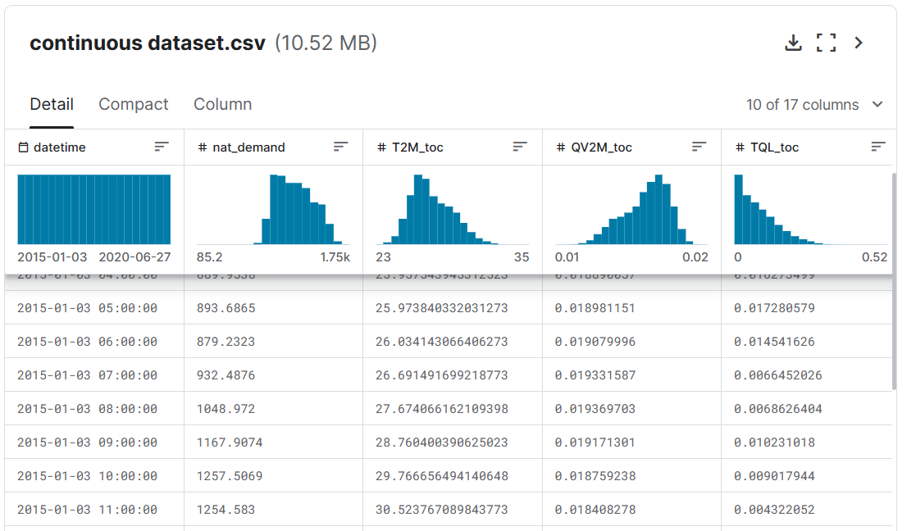
DATASET – Electric Load Forecasting

Slide 8
Preprocessing of data
Loads data from a CSV file containing electricity load forecasting data.
Performs data pre-processing including creating lag features, scaling numerical features, and applying one-hot encoding to categorical columns.
Splits the data into train and test sets.
Prepares the data using TimeseriesGenerator for feeding into the LSTM model.

Slide 9
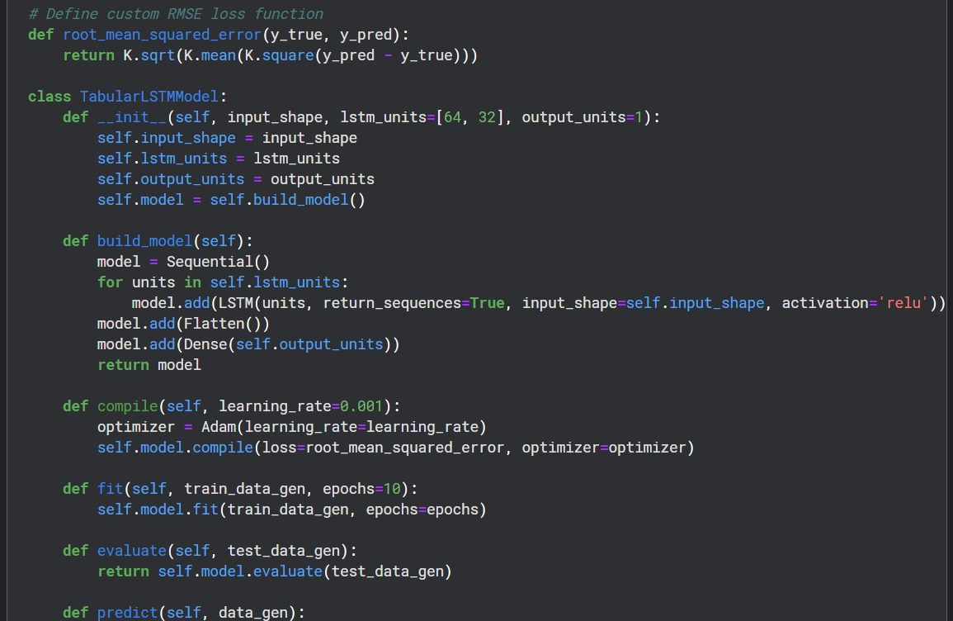
LSTM model

Slide 10
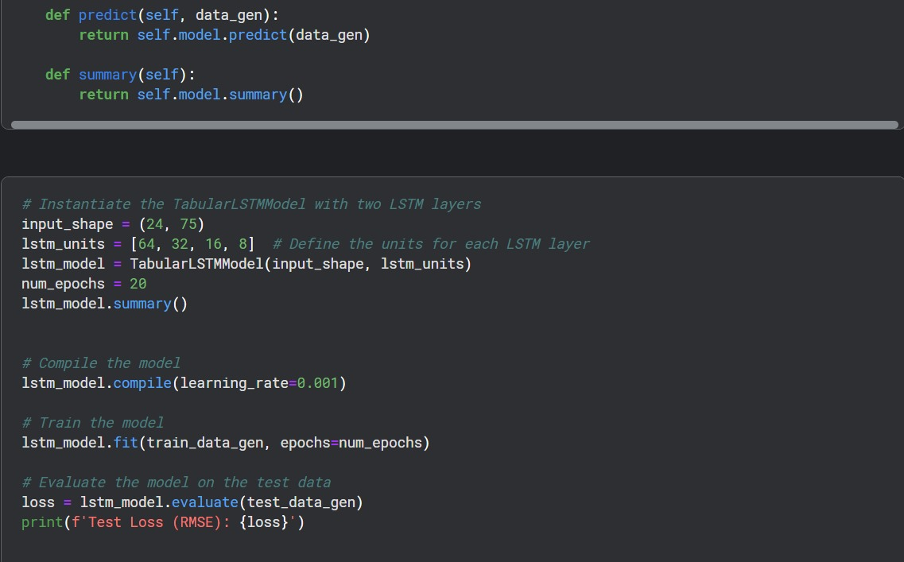

Slide 11
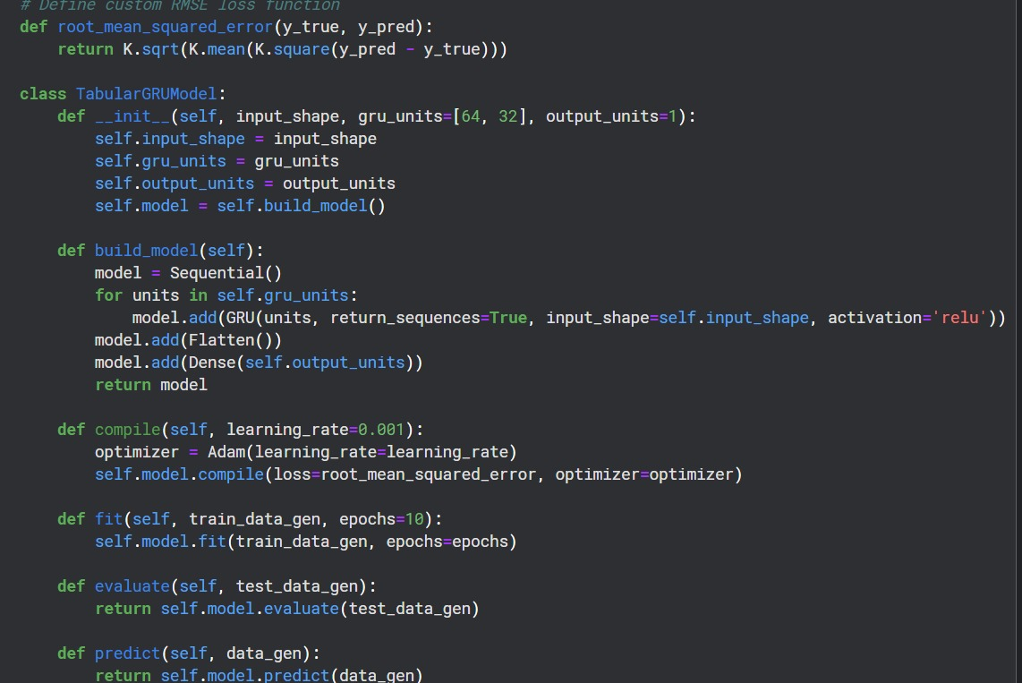
GRU model

Slide 12
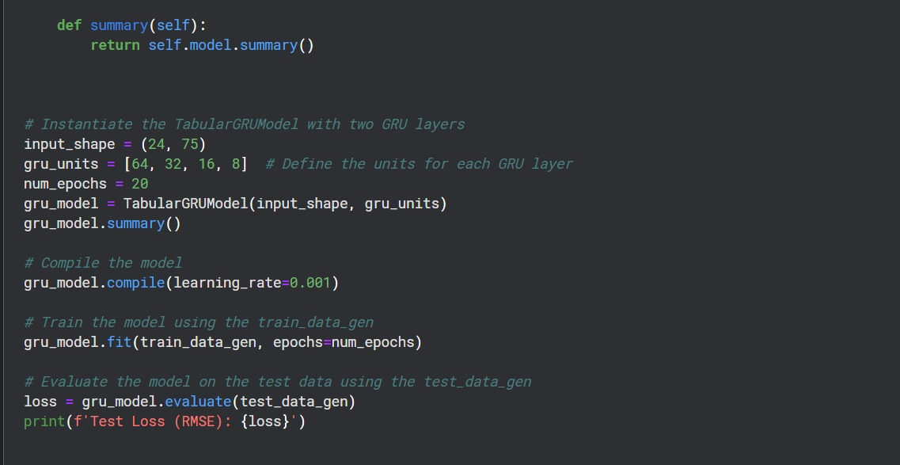

Slide 13
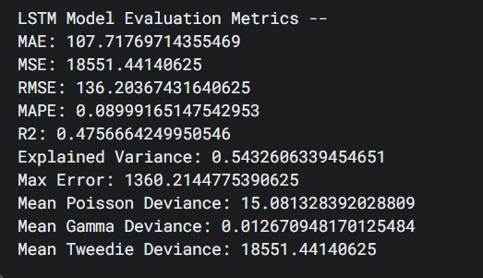
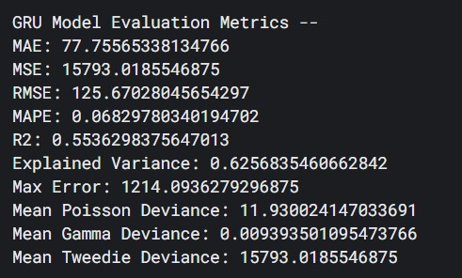
Comparison between LSTM and GRU

Slide 14
Conclusion
In conclusion, this project aimed to forecast electric load using machine learning techniques, specifically LSTM and GRU models. Through evaluation, it was observed that the GRU model outperformed the LSTM model in terms of evaluation metrics. This superiority is attributed to the GRU's simpler architecture and fewer training parameters compared to the LSTM. Hence, for this particular task of electric load forecasting, the GRU model emerges as the optimal choice.

Slide 15
Future work
Use of transformers:
One key advantage of Transformers over LSTMs is their more effective handling of long-range dependencies, due to the self-attention mechanism. This allows them to weigh the importance of various positions in the input sequence, whereas LSTMs might struggle with retaining information from distant positions in longer sequences.

